Slide 1
GEOGRAPHY
LESSON 2
LAND, SOIL, WATER, NATURAL VEGETATION AND WILD LIFE RESOURCES
MODULE 1

Slide 2
What are the three types of resources?
Natural resources
Human made resources and
Human resources

Slide 3
What are natural resources?
Resources that are drawn from nature and used without much modification are called natural resources.

Slide 4
Land
70 % of our earth is covered with water. Land covers only 30 % of the earth’s surface. In this 30 percentage, most of the land is not habitable. For example, desert areas, mountain region, forested areas are thinly populated whereas plains and river valleys are thickly populated. These areas are very fertile and used for agriculture.

Slide 5
The uses of land
Land is used for different purposes
agriculture,
forestry,
mining
building houses, roads and
setting up of industry.

Slide 6
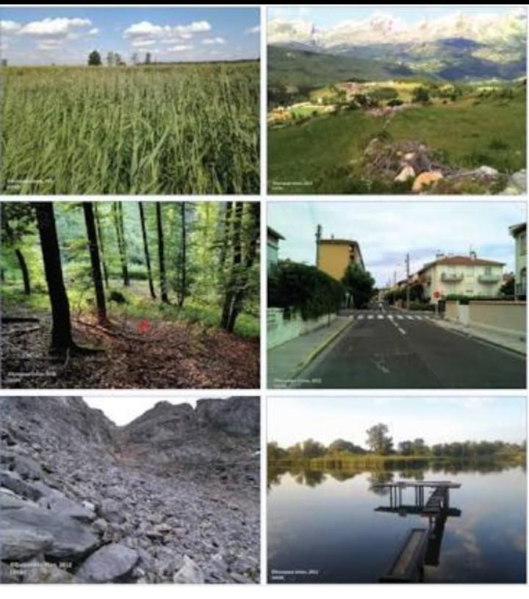

Slide 7
The use of Land is determined by two factors
physical factors
human factors

Slide 8
The physical factors are
topography,
climate,
minerals,
availability of water.

Slide 9
Human factors are
population
technology

Slide 10
Types of land
on the basis of ownership of land, land is divided into two. They are
private land
community land
Private land is owned and operated by individuals. Community land is owned by the community.

Slide 11
People and their demands are ever-growing, but the availability of land is limited. Land degradation, landslides, soil erosion, desertification are the major threats to the environment because of the expansion of agriculture and construction activities.

Slide 12
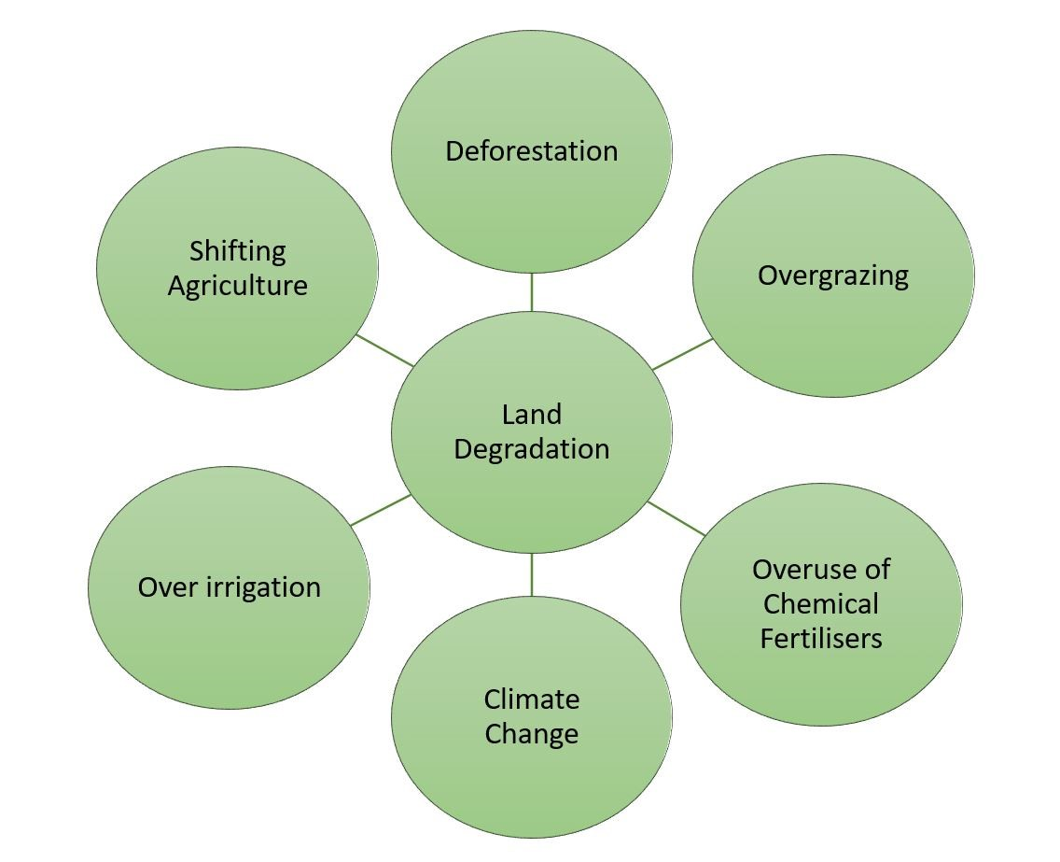

Slide 13
Methods of conservation of land resources are
Afforestation,
land reclamation,
regulated use of chemical pesticide and fertilisers
and checks on overgrazing

Slide 14
Landslides
Landslides are simply defined as the mass movement of rock, debris or earth down a slope. They often take place in conjunction with earthquakes, floods and volcanoes. A prolonged spell of rainfall can cause heavy landslide that can block the flow of river for quite some time.

Slide 15
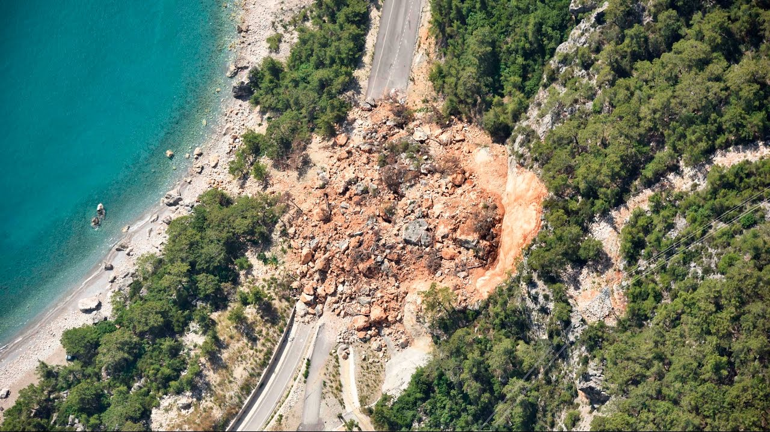

Slide 16
Mitigation mechanism
Hazard mapping to locate areas prone to landslides. Hence, such areas can be avoided for building settlements.
Construction of retention wall to stop land from slipping.
Increase the vegetation cover.
The surface drainage control works to control the movement of landslide along with rainwater and spring flows.

Slide 17
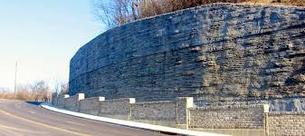

Slide 18


